Slide 1
Class Eleven
Writing for the Web

Slide 2
Overview
What's new?
Quiz
Autopsy
The Chapter
Lab
Attendance
Notes:
5 minutes

Slide 3
What’s New?

Slide 4
Quiz Time
Notes:
10 minutes

Slide 5
Website Autopsy
http://forefathersgroup.com/
http://spacecollective.org/projects/The-great-enhancement-debate
https://www.tumblr.com/
http://www.nfl.com/
http://www.thelivingdoor.com/
http://cupcakeipsum.com/
Notes:
20 - 30 minutes

Slide 6
Break
Notes:
Break – 8 minutes

Slide 7
The Chapter

Slide 8

Writing for the Web
A new frontier
Scannable
Easily digestible
Users read 15% slower online
Notes:
http://www.flickr.com/photos/elrogos/4697925308/sizes/l/in/photostream/

Slide 9
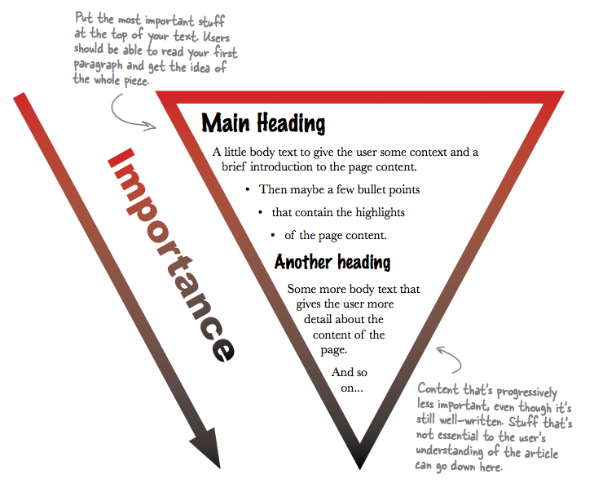
Inverted Pyramid

Slide 10
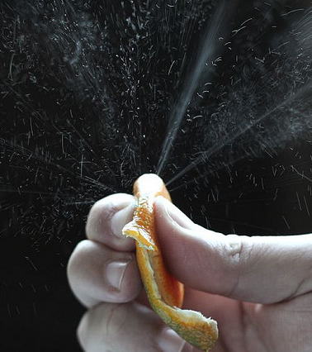
Compress Your Copy
Cut, cut, cut
Use short words and phrases
Two to three sentence paragraphs
Reduce adverbs
Active phrases
Re-read
Notes:
http://www.flickr.com/photos/8050972@N05/1858426882/sizes/z/in/photostream/

Slide 11

Can you read me now?
Re-read
Make lists
Add headings
Practice
Notes:
http://www.flickr.com/photos/mbg_photos/2484112082/sizes/l/in/photostream/

Slide 12
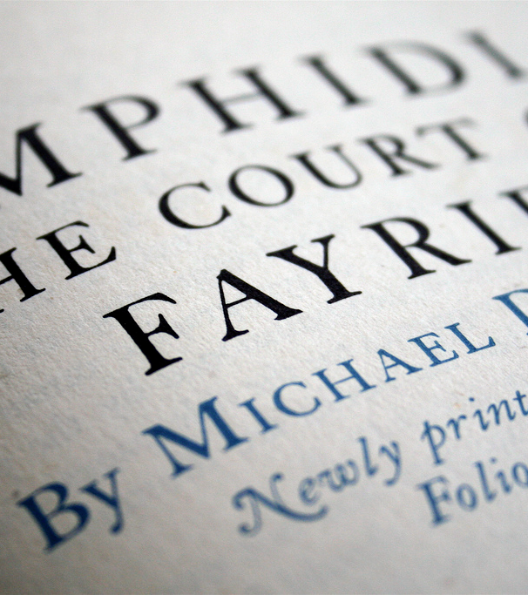
Typography
Mix fonts for emphasis
Serif
Sans-serif
Use headings for level, not size
Notes:
http://www.flickr.com/photos/hubmedia/3147276610/sizes/l/in/photostream/

Slide 13
Break
Notes:
Break – 8 minutes

Slide 14
Lab
Make the USF homepage:
http://dl.dropbox.com/u/41609448/art329/slides/classten/usiouxfallsedu.zip

Slide 15
Class Twelve

